Slide 1
Senior Design:
Low Carbon Blockchain
(LCB)
Agron Gemajli, Shivam Patel, Ghulam Afzal, Adrian Torres
Advisor: Phillip G. Bradford

Slide 2
Overview of LCB / Problem Statement
Current blockchain technologies operate under Proof of Work (PoW) algorithms.
i.e) Hashcash PoW
PoW methods construct hash chains to build trust within blockchains.
Problem: PoW algorithms burn a lot of energy.

Slide 3
Our Solution
Replace hashcash or other PoW methods with a lottery and proof-of-VM (PoVM) emulation.
A PoVM blockchain that may have a lower CO₂ footprint than tradition PoW blockchains.
Peer-to-peer blockchain-like system that leverages containers.
Notes:
PoVM emulation is a form of PoW where
an autonomous blockchain miner gets a lottery ticket for providing a {\em VM (virtual Machine)} for general use in a network
for a specified period.

Slide 4
Why this Solution?
Peer to peer workload reduces carbon emissions due to distributed processing of tasks across nodes.
Optimal utilization of idle nodes used to compute workloads.
Increased resiliency of distributed network by providing a fault tolerant system.

Slide 5




Technology Stack
Apple Mac OS
The operating system used for operating the proof of technology
Docker
Platform to deliver software through containers.
Kubernetes (K8s)
Open source tool to manage containerized workloads through Docker
Skupper
Open source tool to create virtual application network (VAN) within K8s.

Slide 6
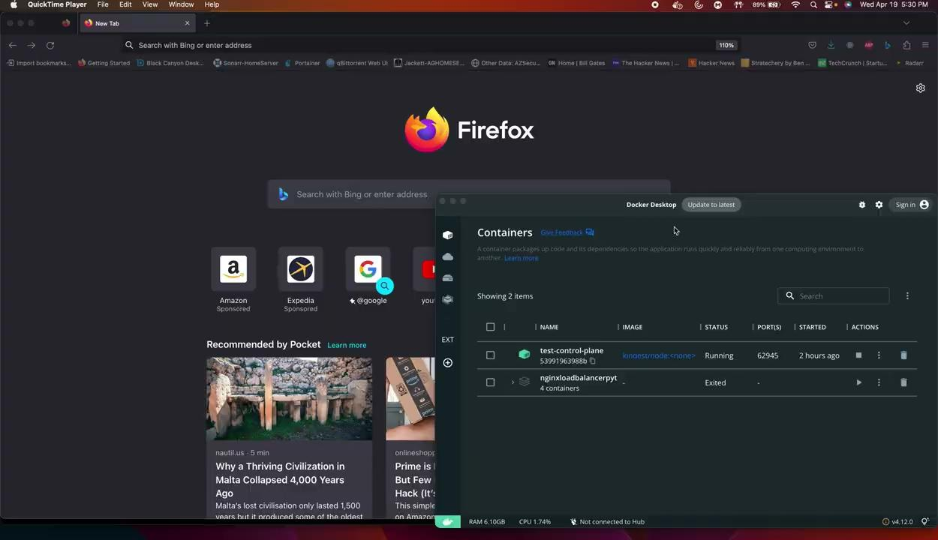
Demo

